Slide 1
Name: vishwa chaturvedi
Sem :2
Div: b
Enroll no: 201806100110127
Sub: Environment

Slide 2
Topic : solid waste manage-
Ment

Slide 3
What is solid waste management
Solid waste management is that material which
arises from various human Activities like
(domestic trash ,garbage ,metal scrap , etc.)
and which is normally Discarded as useless or
Unwanted . It is responsible for land pollution in
urban and Industrial area .

Slide 4
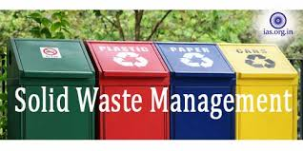
IMPORTANCE OF SOLID WASTE MANAGEMENT

Slide 5
The most important reason for proper waste management is to protect the environment and for the health and safety of the population.
Cost savings – managing the waste your business produces can result in valuable materials to reuse. This can save you money while potentially creating new jobs and business opportunities.
Workplace safety – storing and disposing your rubbish in the wrong place can be harmful to employees or customers. If you work with sharp objects, dangerous fumes and chemicals, you will need special procedures for how you dispose of them.

Slide 6
Solid waste management in house-holds

Slide 7
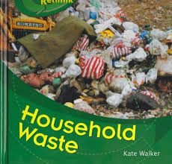
Let’s first know what house-hold waste management refers to:--
Household waste management refers to separating the household waste into different parts, and then turning the waste materials into useful resources. It also can be called household waste sorting plant or household waste recycling plant.

Slide 8
Generally ,the household waste mainly can be finally divided into four parts:
1. Recyclable waste, including plastic, paper, glass, etc.;
2. Kitchen garbage, including leftovers, bones, cabbage and other food waste; kitchen waste is mostly degradable;
3. Hazardous waste, including waste batteries, waste fluorescent tubes, waste mercury thermometer, expired drugs, and these garbage materials need special and safe management;
4. Other garbage: in addition to the above types of garbage, the brick and tile ceramics, dregs and other materials also need to be disposed specially.

Slide 9
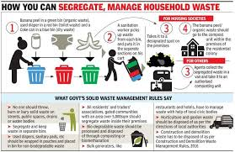
Benefits of solid waste management in house-hold.
1. Economic benefits
The household waste sorting machine will save a lot of land and capital. It is an environmental “waste to energy” project and turns waste into useful resources, which will create great profits and drive the economic improvement.

Slide 10
2. Social benefits
The household waste management plant belongs to a social welfare environmental-protection project, which can improve the living environmental for people, and also improve the ecological environment and promote the economic construction of the city.
The implementation of this project has fundamentally solved the harm caused by the household waste, and protected the country’s land resources. The establishment of the household waste recycling plant can not only create economic benefits, but also bring real and long-term social benefits.

Slide 11
3. Environmental benefits
The garbage disposal plant project will provide new treatment sites for the urban and rural garbage, and the household waste can be fully reduced, reused and recycled. On the one hand, the construction of household waste treatment equipment can eliminate the water, soil and air pollution caused by the garbage, to protect the nearby water safety and effectively reduce the incidence of infectious diseases; on the other hand, the management of household waste can also reduce the loss of agriculture, animal husbandry, fisheries caused by garbage, and promote the development of social productive forces.

Slide 12
What can we do to reduce the house-hold garbage

Slide 13
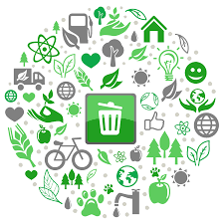
THE SIMPLEST WAYS TO REDUCE THE HOUSE-HOLD SOLID WASTE ARE:
1.REFUSE:The uses of non bio-degradable materials.
2.REDUCE:The use of materials which are harmful to environment.
3.REUSE:The materials which you can for multiple times.
4.REPAIR:Make habit of repairing the thing and using them instead of throwing them away.
5.RECYCLE:Keep recycling the things as much times
recycling is possible to reduce the amount of
waste produced.

Slide 14

GO GREEN
Thank you

